Slide 1


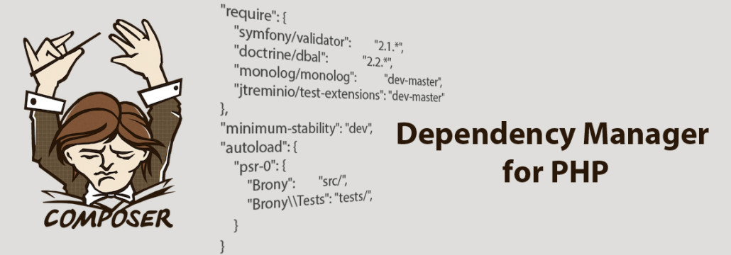
Composer packages
Installing and Using Composer, Packagist, Packaging your code
Mario Peshev
Technical Trainer
http://peshev.net
Software University
http://softuni.bg

Slide 2

Table of Contents
PHP package
Composer overview
Advantages
Download and install
Autoloading
Packagist
Using Composer
Packaging your own code
Famous Libraries Examples

Slide 3

PHP package
import(‘weatherForecast.arras.*’);
include(‘weather.arras.*’);

Slide 4
What is PHP package?
A directory containing something. In this case it is PHP code, but in theory it could be anything.
Used to help you logically group related elements just like you write classes to group related functions and data together.

Slide 5

Composer overview
requires PHP 5.3.2+ to run

Slide 6
What is Composer?
Dependency manager for PHP.
List your project’s dependencies in a composer.json file and with a few simple commands - Composer will automatically download your project’s dependencies and setup autoloading for you.

Slide 7
What is Composer?
It is not a package manager.
It deals with "packages" or libraries, but it manages them on a per-project basis, installing them in a directory (e.g. vendor) inside your project.
By default it will never install anything globally.

Slide 8

Advantages

Slide 9
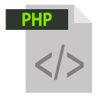
Why use Composer?
lot of PHP libraries that are compatible with Composer
Already use PHP framework
ready to be used in your project
these “packages” are listed on
Packagist is the official repository for Composer-compatible PHP libraries!

Slide 10

Download and Install

Slide 11
Download and Install for NON-Windows users
Download: $ curl -sS https://getcomposer.org/installer | php
If you don’t have curl:
$ php -r "readfile('https://getcomposer.org/installer');" | php

Slide 12
Download and Install for NON-Windows users
recommended directory is /usr/local/bin
install composer to a specific directory:
$ cd /path/to/my/project
$ curl -sS https://getcomposer.org/installer | php -- --install-dir=bin

Slide 13
Download and Install on Windows
Download https://getcomposer.org/Composer-Setup.exe
php -r "readfile('https://getcomposer.org/installer');" | php
If you don’t use the Composer-Setup installer - don’t forget to set up your $PATH so that you can just call composer from any directory in your command line.

Slide 14

Packagist

Slide 15
Packagist
Packagist is the main Composer repository
A Composer repository is a place where you can get packages from
You can automatically require any package that is available there
https://packagist.org – You can browse all available packages on the official website

Slide 16

Using Composer

Slide 17
Autoloading
To use it, just add the following line to your code's bootstrap process:
require ‘vendor/autoload.php’;

Slide 18
Adding a library
To add a library to your project, create a file named composer.json with content that resembles this example:
You must run composer to have your dependencies installed:
$ php composer.phar install
{
"require": {
"illuminate/foundation": "1.0.*“
},
"minimum-stability": "dev“
}

Slide 19
Using Composer
Live Demo

Slide 20

Packaging Your Own Code

Slide 21

Packaging Your Own Code
Using custom repositories key:
"repositories": [
{
"type": "package",
"package": {
"name": "weaverryan/derp-dangerzone",
"version": "dev-master",
"source": {
"url": "git://github.com/weaverryan/derp-dangerzone.git",
"type": "git",
"reference": "master"
},

Slide 22
Packaging Your Own Code (2)
"autoload": {
"psr-0" : {
"Weaverryan\\DangerZone" : "src"
}
}
}
}
],

Slide 23
Packaging Your Own Code (3)
You can later require it
"require": {
"weaverryan/derp-dangerzone": "dev-master"
},

Slide 24
Packaging Your Own Code (4)
You can simplify the packaging by creating a composer.json file in the library itself with a simillar content
Version and Source keys are removed. Composer will look at branches and tags to get information
{
"name": "weaverryan/derp-dangerzone",
"autoload": {
"psr-0" : {
"Weaverryan\\DangerZone" : "src"
}
}
}

Slide 25
Packaging Your Own Code (5)
Update your composer.json to have the following:
Now, instead of a packages key, you have a simpler vcs key, which consumes the repository's composer.json file
"repositories": [
{
"type": "vcs",
"url": "https://github.com/weaverryan/derp-dangerzone"
}
],

Slide 26
Registering with Packagist
In order to register you package with packagist you have to fill a form in the official website
Once you have registered you library with Packagist and it has been crawled – you can use it by just requiring it
"require": {
"weaverryan/derp-dangerzone": "dev-master"
},

Slide 27
Packaging Your Own Code
Live Demo

Slide 28

Famous Libraries Examples

Slide 29
Facebook SDK
The Facebook SDK is added to Packagist
Run composer and you will have a file named composer.lock and a directory named vendor
The lock file sets the dependency to one specific revision
In the vendor directory you will find the Facebook SDK
{
"require": {
"facebook/php-sdk": "dev-master"
}
}

Slide 30
PHP Unit
The Unit Testing library PHP Unit is also added to Packagist
{
"require": {
"phpunit/phpunit": "4.3.*@dev"
}
}

Slide 31
Laravel Framework
The Famous MVC Framework – Laravel can be obtained from Packagist too
And a thousand more libraries on Packagist…
{
"require": {
"laravel/laravel": "dev-master" }
}

Slide 32
Famous Libraries Examples
Live Demo

Slide 33


Summary
Easy to use – just list your dependencies
in a composer.json file
Packagist is the default package repository
You can package your own code
You can submit your package to Packagist
PHP & MySQL

Slide 34
PHP & MySQL
https://softuni.bg/trainings/fasttracks/details/1033

Slide 35
License
This course (slides, examples, demos, videos, homework, etc.) is licensed under the "Creative Commons Attribution-NonCommercial-ShareAlike 4.0 International" license
Attribution: this work may contain portions from
"PHP Manual" by The PHP Group under CC-BY license
"PHP and MySQL Web Development" course by Telerik Academy under CC-BY-NC-SA license

Slide 36





Free Trainings @ Software University
Software University Foundation – softuni.org
Software University – High-Quality Education, Profession and Job for Software Developers
softuni.bg
Software University @ Facebook
facebook.com/SoftwareUniversity
Software University @ YouTube
youtube.com/SoftwareUniversity
Software University Forums – forum.softuni.bg

